Slide 1

Welcome to our class

Slide 2
Warm - up: GUESSING
2 groups: A & B
1 student gets a list of words or phrases
She/he doesn’t say anything and uses body language to express
The others try to guess what you means.

Slide 3
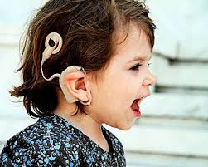
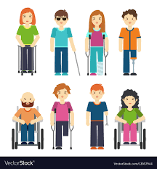
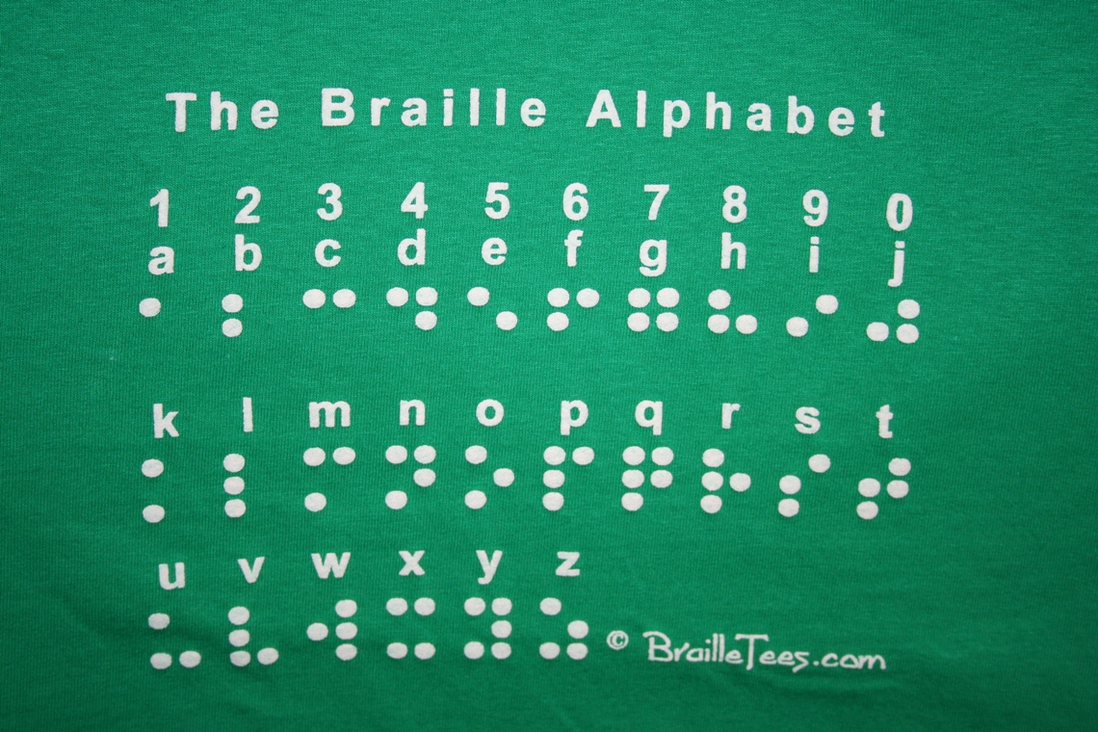

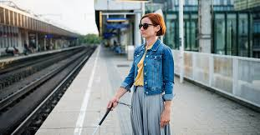
Who uses sign language or the Braiile Alphabet to express what they mean?
The dumb
=> They are
The blind
The deaf
are called…
The disabled

Slide 4
Topic 4: Special Education
Lesson 1. Reading

Slide 5
I. Before you read:
TOPIC 4: SPECIAL EDUCATION - LESSON 1: READING
Teaching Vocabularies

Slide 6
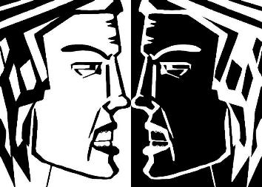
TOPIC 4: SPECIAL EDUCATION - LESSON 1: READING
- to oppose to sb/st (v):
Eg: They don’t agree with each other. They oppose to others’ ideas.
Phản đối ai/cái gì
- opposition (n):
Sự phản đối

Slide 7
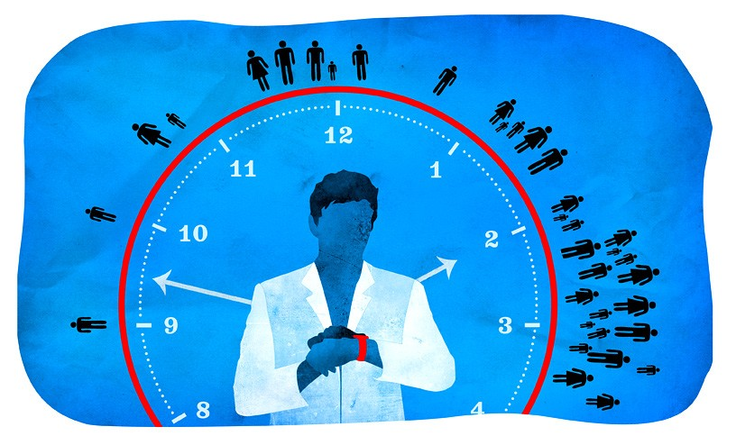
TOPIC 4: SPECIAL EDUCATION - LESSON 1: READING
time-consuming (adj) =
taking a lot of time

Slide 8
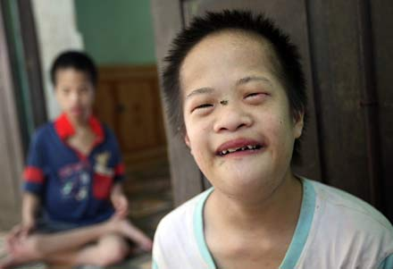
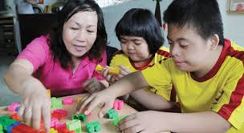
TOPIC 4: SPECIAL EDUCATION - LESSON 1: READING
Chậm phát triển trí tuệ
Mentally retarded ['mentəlɪ] [rɪ'tɑ:rdɪd]

Slide 9
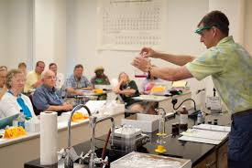
TOPIC 4: SPECIAL EDUCATION - LESSON 1: READING
An act of showing or explanation how to do something
demonstration (n) [deməns'trei∫n]
sự thể hiện, sự thuyết minh

Slide 10


Gradually (adv) /ˈɡrædʒuəli/
Slowly, over a long period of time.

Slide 11
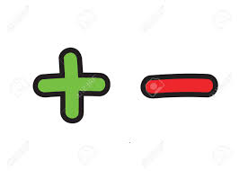
Add (v)
Subtract (v)

Slide 12
TOPIC 4: SPECIAL EDUCATION - LESSON 1: READING
Teaching vocabulary
Dumb (adj)
Blind (adj)
Deaf (adj)
Disabled (adj)
The + adj (n)
Time-consuming (adj)
- to oppose to sb/st (v)
→ opposition (n)
- Demonstration (n)
Gradually (adv)
Mentally retarded
Add >< subtract (v)

Slide 13
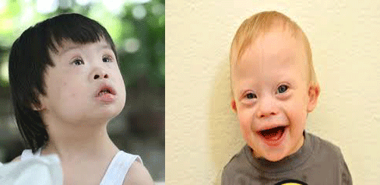


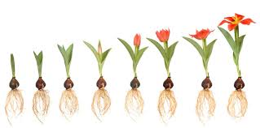
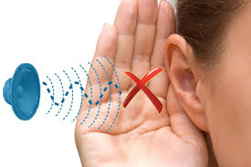

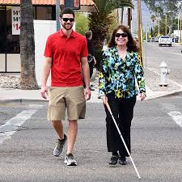
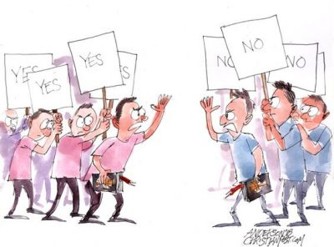
Checking vocabulary

Slide 14
TOPIC 4: SPECIAL EDUCATION - LESSON 1: READING
II. WHILE YOU READ
Task 1: Read the passage again and answer the following questions
How many children are there in her class?
2. Who are they?
3. Do they live in poor or rich families?
4. What does the teacher use to teach the children Maths?
=> There are 25 children in her class.
=> They are disabled.
=> They live in poor families.
=> The teacher uses her fingers to teach the children Maths

Slide 15


TOPIC 4: SPECIAL EDUCATION - LESSON 1: READING
II. While you read
Task 2:
Read the passage again and complete the following sentences by circling the corresponding letter A, B, C, or D.

Slide 16
TOPIC 4: SPECIAL EDUCATION - LESSON 1: READING
1. At first the parents were.........the idea of sending their children to the special class.
A. interested in
B. opposed to
C. satisfied with
D. worried about
*→The evidence
(Line 1 to 5 in paragraph B)
“At first, there was a lot of opposition from the parents
of the disabled children. They used to believed that
Their children couldn’t learn anything at all”

Slide 17
TOPIC 4: SPECIAL EDUCATION - LESSON 1: READING
2. It can be inferred from the second paragraph of the reading passage that there has been……
A. a change in the parents’ attitude towards the class.
B. a lot of protest from the parents against the class.
C. a feeling of doubt in the teacher’s ability.
D. a belief in the parents’ opposition
*→The evidence
(Line 4 to 9 in paragraph B)
“In the first week, only five children attended the class.
Gradually more children arrived. Their parents realised
that the young teacher was made great efforts to help
their poor kids”

Slide 18
TOPIC 4: SPECIAL EDUCATION - LESSON 1: READING
3. The writer describes how Thuy teaches the children to add and subtract in order to prove that……..
A. the children like Maths.
B. the teacher is proud of her work.
C. the teaching work takes time.
D. adding and subtracting are important.
→The evidence
(Line 1 to 5 in paragraph C)
“Watching Thuy taking a class, one can see how
time-consuming the work is. During the maths lesson,
she raised both arms and opened up her fingers one by
one until all ten stood up. She then closed the finger
one by one”

Slide 19

TOPIC 4: SPECIAL EDUCATION - LESSON 1: READING
4. The writer’s attitude towards Thuy’s work in the passage can be described as.......
A. humorous.
B. angry.
C. suspicious.
D. admiring

Slide 20
III. After you read:
Look at the activities. Which ones do you think would be
difficult for blind, deaf, and mute children?
Activities | Deaf | Mute/ dumb | Blind
Singing a song
Pronouncing words
Writing a letter
Listening to music
Phoning friends
Reading books
Watching television








E.g: Singing a song and pronouncing words would be difficult for dumb children.

Slide 21

Learn new words by heart.
Read the passage again and do After you read part.
Prepare new lesson: Topic 4 - Speaking.

Slide 22


Thank you for
your attention
Good bye. See you later!

